Slide 1
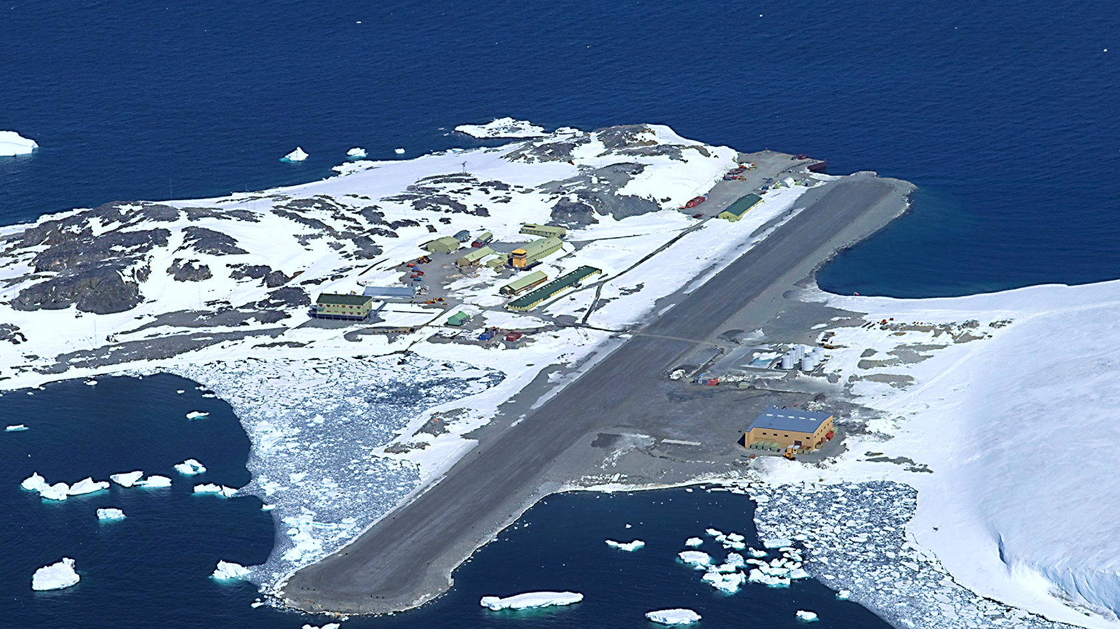
Optimising Remote Field Station Food Purchasing
Sophie Turner
Notes:
MRes project
Optimising remote field station food purchasing

Slide 2
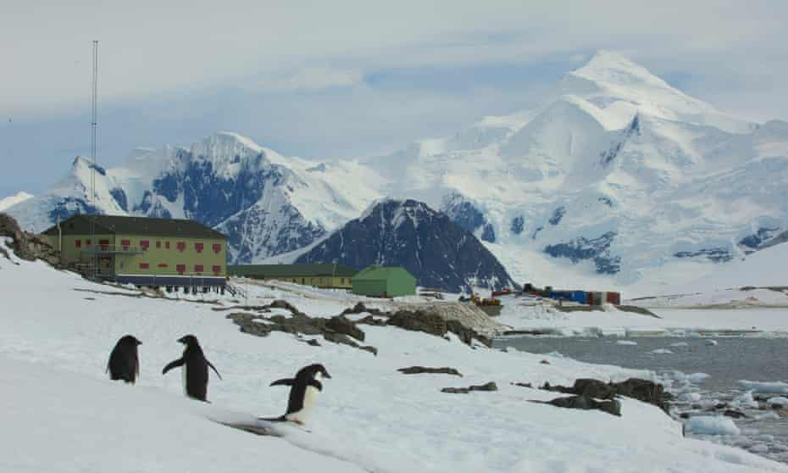

Rothera research station
Notes:
With BAS
Rothera is their largest station.
22 to 170 people year-round.
18 month contracts.
Food brought on SDA yearly.
Operations team.
BAS want to optimize this process.

Slide 3
GWP = global warming potential kg CO₂e
Notes:
Terminology.
Rough average estimates.

Slide 4
The Future of Food in the Antarctic: a report prepared
for the British Antarctic Survey investigating the carbon
intensity of food supplied to an Antarctic research station
Edmund Dickens, 2021, University of Exeter
~ 263,919 kg CO₂e
~ 2 million km
~ 189 cars
Notes:
Last year, Edmund from Exeter worked with BAS on this topic.
He wrote a report on …. title
He estimated the GWP of food brought to Rothera in 2020 to be 264 t.
To get a relatable perspective, this is roughly equivalent to ....
It’s hard to say how accurate this figure is bc lack of data.
I used this as my baseline because it’s the only estimate we have.
I made my own estimate and assumptions without looking at Edmund’s calculations and got a very similar figure to this.
Cost and waste are unknown. No data. Focus on GWP for this presentation.

Slide 5
GWP Cost Food waste Packaging waste
Enjoyment
Variety
Nutrition
Allergies
Logistics
Notes:
Minimise, maximise, constrain.
Logistics includes planned schedules for people and vehicles, storage.

Slide 6
How to model the problem?
Lack of data
Constraint satisfaction problem
Nutrition Allergies Logistics
Multi-objective optimisation problem
Emissions Cost Food waste Packaging waste Variety
Notes:
ML not applicable.
NN not applicable.
Define CSP
Explain opt
CSP with optimising obj fn

Slide 7
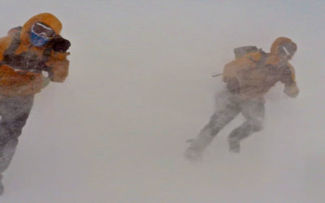
~ 3261
> 4000
Notes:
Hard work. Average calories. Max calories.

Slide 8
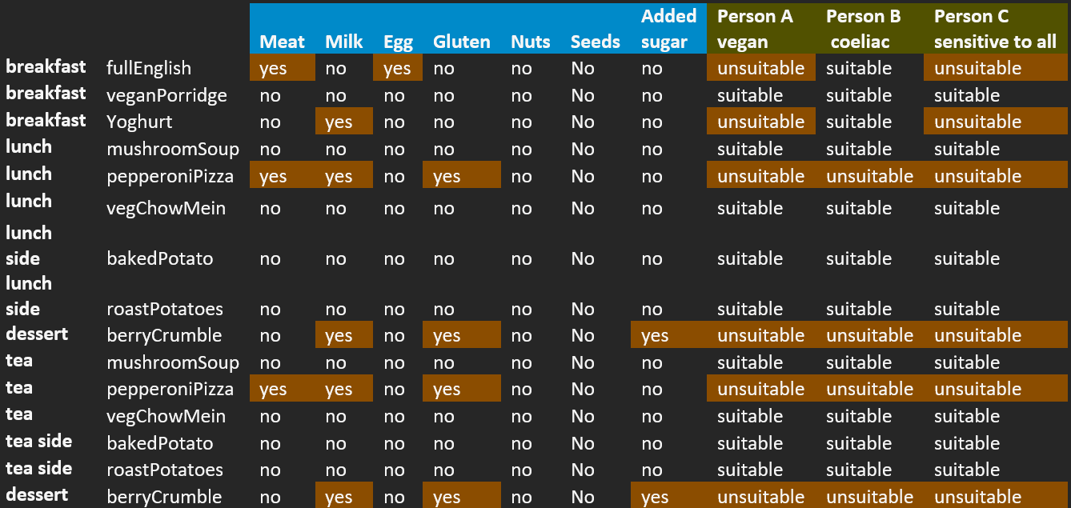
Notes:
Meal options
Allergens
Example people

Slide 9
Notes:
Explain the axes
Explain the trends of each objective

Slide 10
Notes:
Example meal plan

Slide 11
… and so on …
Notes:
Example shopping list

Slide 12
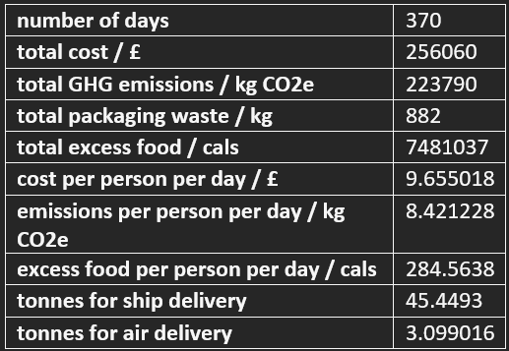
Notes:
Example order summary

Slide 13


≈
316,720 kg CO₂e
263,919 kg CO₂e
221,370 kg CO₂e
~ 2.4 million km
~ 227 cars
~ 2 million km
~ 189 cars
~ 1.68 million km
~ 158 cars
16 %
31 cars
Notes:
Compare unoptimized to optimised bc no real data

Slide 14
Image references
Background picture - National Science Foundation. (2016). Rothera, the British Antarctic Survey station on the Antarctic Peninsula. Available: https://nsf.gov/news/mmg/media/images/Rothera%20station.jpg. Last accessed 5th Jul 2022.
Slide 2 - Bucktrout, P. (2020). Rothera on Adelaide Island. Available: https://www.theguardian.com/world/2020/nov/01/next-stop-antarctica-british-team-covid-free-coronavirus. Last accessed 5th Jul 2022.
Any questions?

